Slide 1

Sarcasm Detection
Team Members :
Vishesh Paka
Jahnavi Chowdary Tumati
Srikar Rambhatla

Slide 2
INTRODUCTION
The subtle nature of language and contextual dependencies makes sarcasm detection in textual data especially news headlines extremely difficult.
In this work, we introduce a novel method for sarcasm detection based on a carefully selected dataset from reliable news sources, including HuffPost and The Onion. By utilizing expertly crafted news headlines, we hope to improve the precision and consistency of sarcasm detection systems while circumventing the drawbacks of the existing Twitter-based datasets.
Our approach starts with a thorough pre-processing of the data to guarantee its consistency and quality.
Using Word2vec and Glove embeddings, we train machine learning models specifically designed for sarcasm detection tasks.

Slide 3

OBJECTIVE
The performance of sarcasm detection algorithms is impacted by the limitations of existing datasets sourced from social media platforms such as Twitter which are often noisy and lack contextual information.
Our objective is to create a model that can detect sarcasm in news headlines that have been expertly crafted, thus improving accuracy and expanding the model's usefulness in real world scenarios.

Slide 4
DATASET
The dataset comprises approximately 28,000 news headlines categorized as Sarcastic or Not Sarcastic which offers unrestricted access.
Each headline is associated with a label indicating its sarcasm status.
The dataset can be accessed through the following links:
Sciencedirect Article
GitHub Repository
This dataset acquisition process underscores the importance of utilizing credible and well-labeled datasets for robust and meaningful research outcomes in sarcasm detection.

Slide 5

METHODOLOGY
Data collection and Preprocessing
Model selection and comparison
Training and evaluation
Analysis and interpretation
Documentation and reporting

Slide 6
APPROACH
Our approach integrates data collection, preprocessing, model selection, training, and evaluation for sarcasm detection in news headlines.
We utilize curated datasets from TheOnion and HuffPost known for professional and sarcastic headlines.
After data preprocessing, we employ Word2Vec and GloVe word embedding models for vector representation.
Model selection is followed by training and performance assessment using standard metrics.
Key variables influencing accuracy are identified through evaluation.
Comprehensive documentation summarizes findings and suggests further research in sarcasm detection

Slide 7
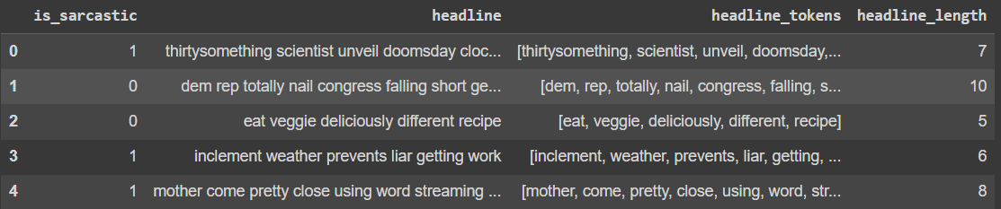
DATA PRE-PROCESSING
Convert to Lowercase
Remove Punctuation
Remove Numbers
Strip HTML Tags
Remove Content in Square Brackets
Remove URLs
Remove Stopwords
Lemmatization
Our final processed sample data:

Slide 8
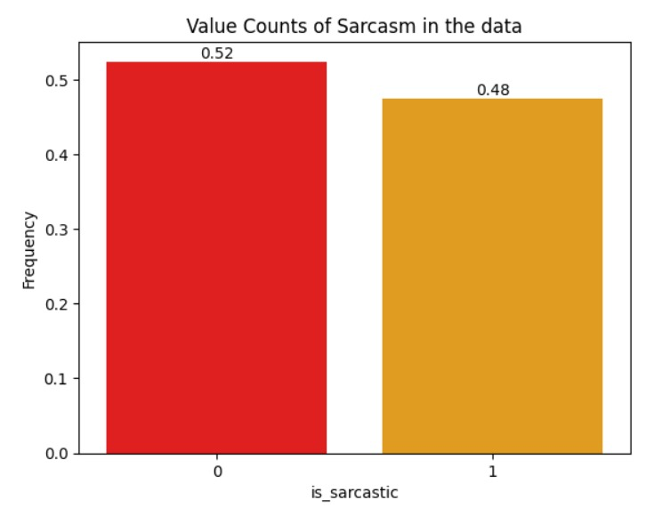
LABEL DISTRIBUTION
We can see that the dataset is balanced having almost equal representation of each class in the dataset.

Slide 9
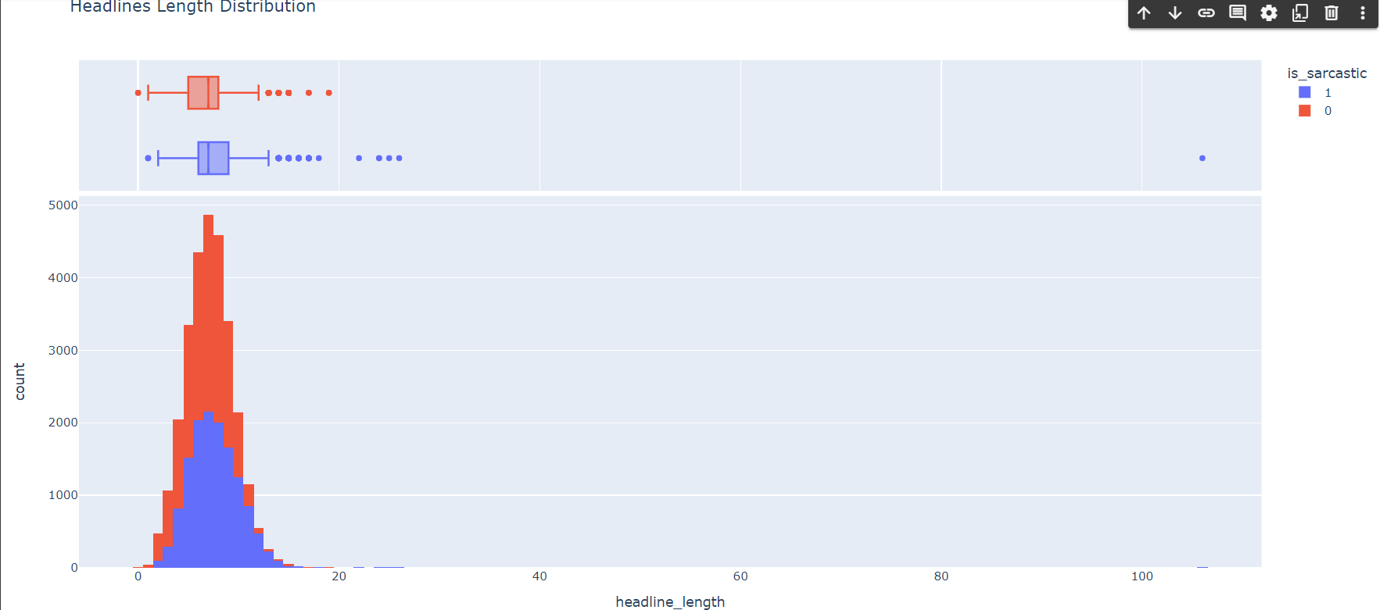
Headline Length Distribution
Understanding headline length distribution is crucial in NLP, especially for sarcasm detection. We analyze headline lengths, focusing on outliers to ensure concise inputs for models.
Using Plotly Express, we visualize headline length distribution, aiming to identify variations in structure. Ideal headlines for NLP tasks range between 20 to 30 words.

Slide 10
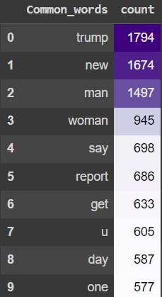
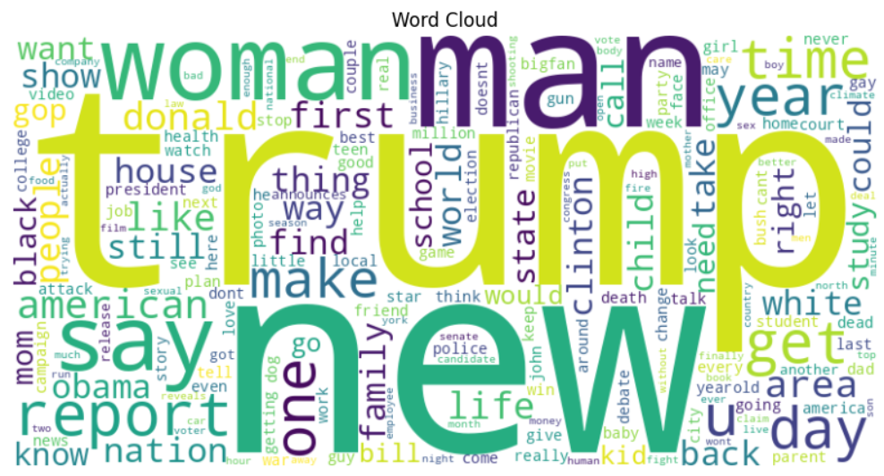
Word Frequency Analysis
Word frequency analysis is essential for uncovering prevalent terms and patterns in news headlines. Using NLTK, we preprocess data and employ the Counter module to quantify word occurrences. The code generates word clouds, visually representing word frequencies in the dataset and distinguishing between sarcastic and non-sarcastic headlines. These visualizations aid in feature identification for subsequent analysis.
.

Slide 11
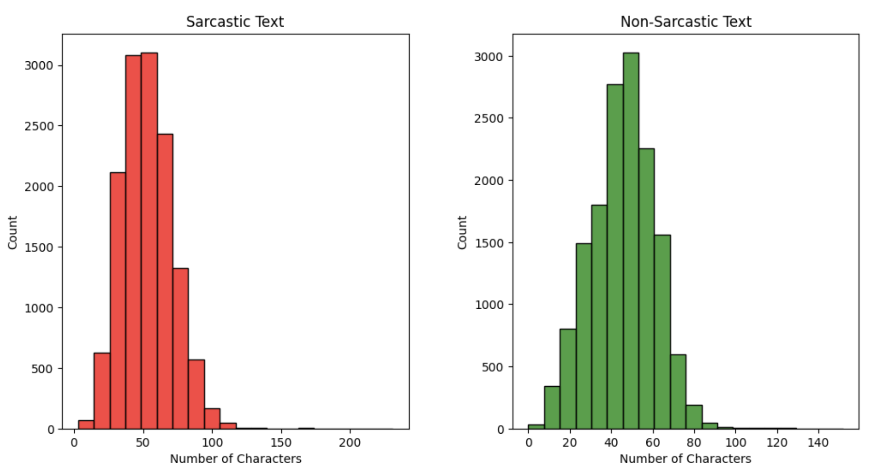
Character length distribution in headlines
.

Slide 12
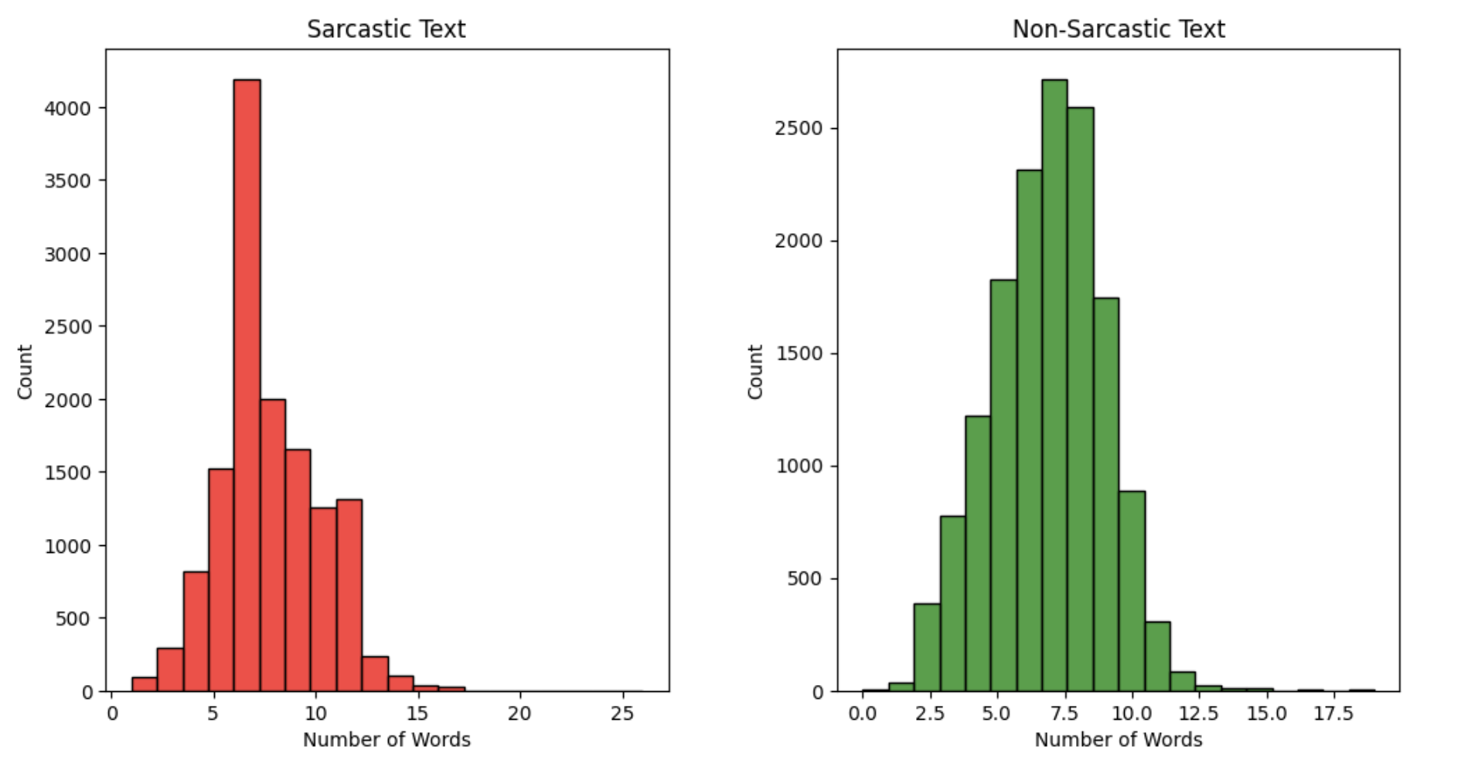
Words distribution in headlines
.

Slide 13
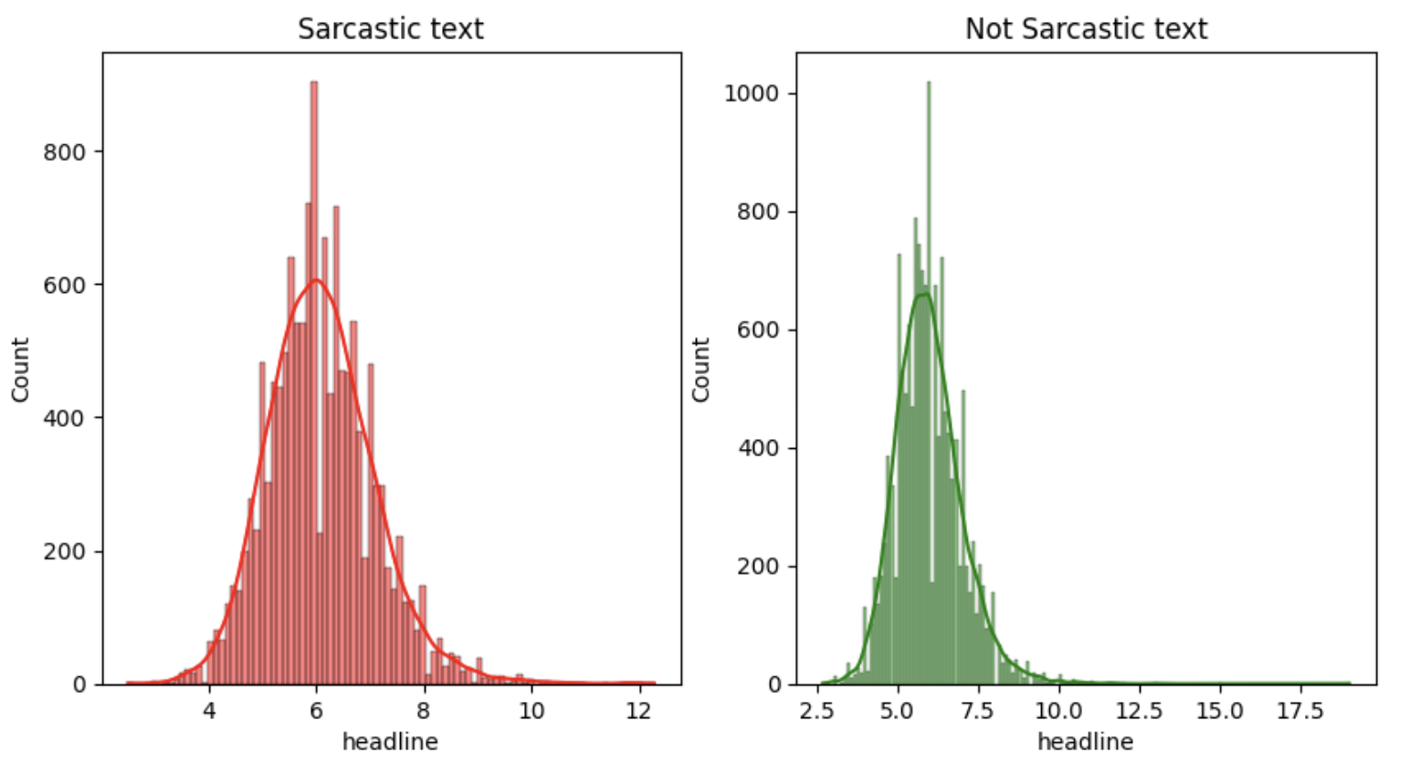
Average word length in each headline
.

Slide 14
LSTM Models
Our study employs a neural network architecture for sarcasm detection in news headlines. It features:
Embedding layer (200 dimensions)
Bidirectional LSTM and GRU units with dropout regularization
Dense layer with sigmoid activation for binary classification
Adam optimizer (learning rate: 0.001)
We evaluate model performance using accuracy and loss metrics across epochs. Plots illustrate training/testing accuracy and loss, offering insights into learning progress and generalization ability. Critical for NLP sarcasm detection assessment.

Slide 15
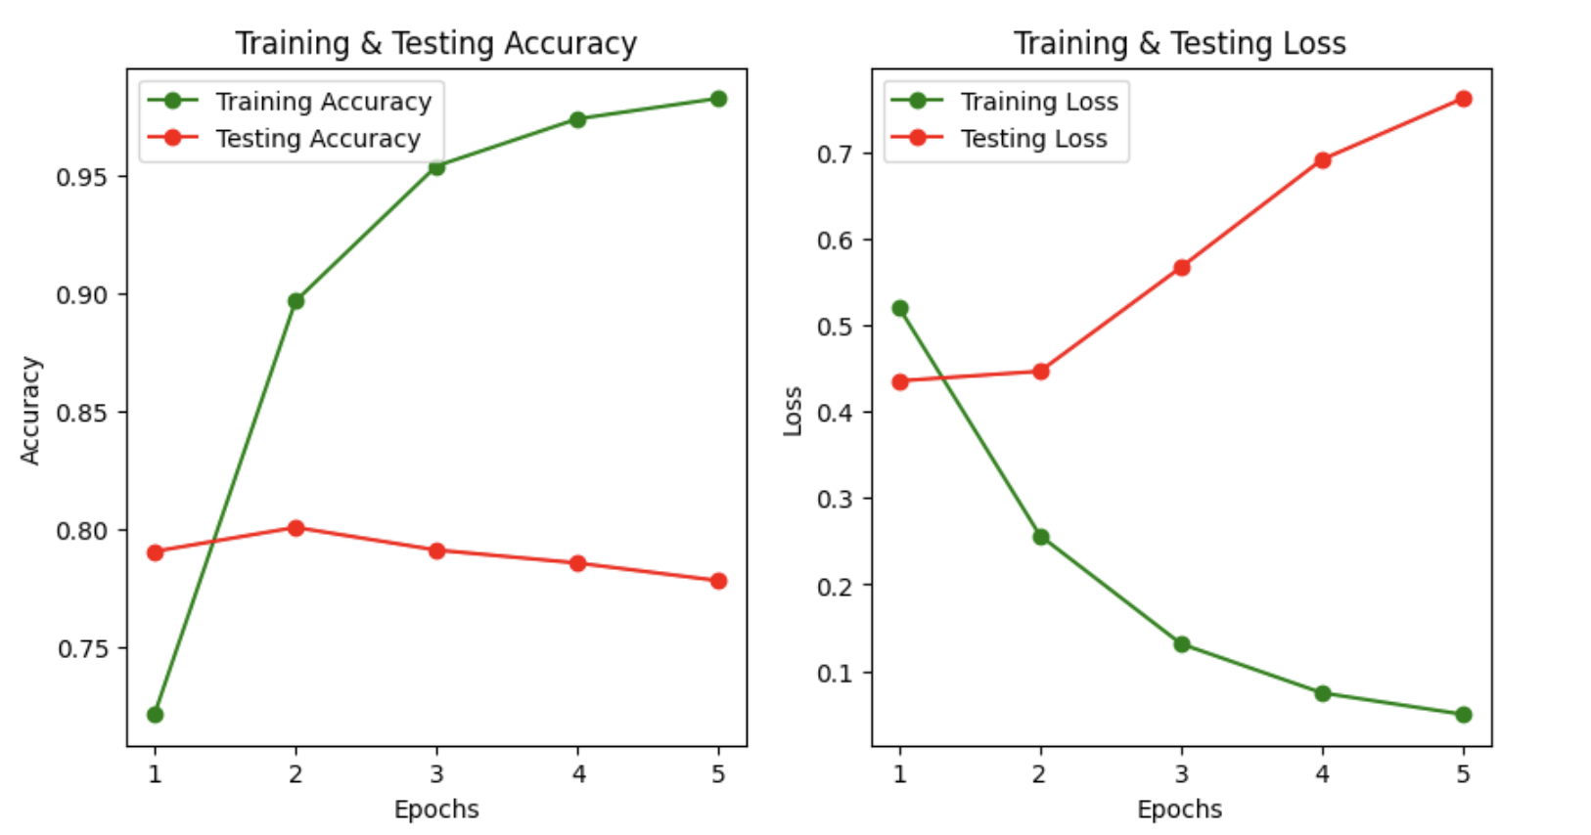
Analysis of Bidirectional LSTM, GRU model with accuracy and loss : The training accuracy of the model is exceptionally high at 99.42%, indicating that it performs very well on the training data. However, when evaluated on the testing data, the accuracy drops to 78.87%. This significant drop suggests that the model may be overfitting to the training data, meaning it is learning to memorize the training examples rather than generalize well to unseen data. One possible reason for this overfitting could be the high complexity of the model architecture, which may lead to excessive parameter tuning and capturing of noise in the training data.

Slide 16
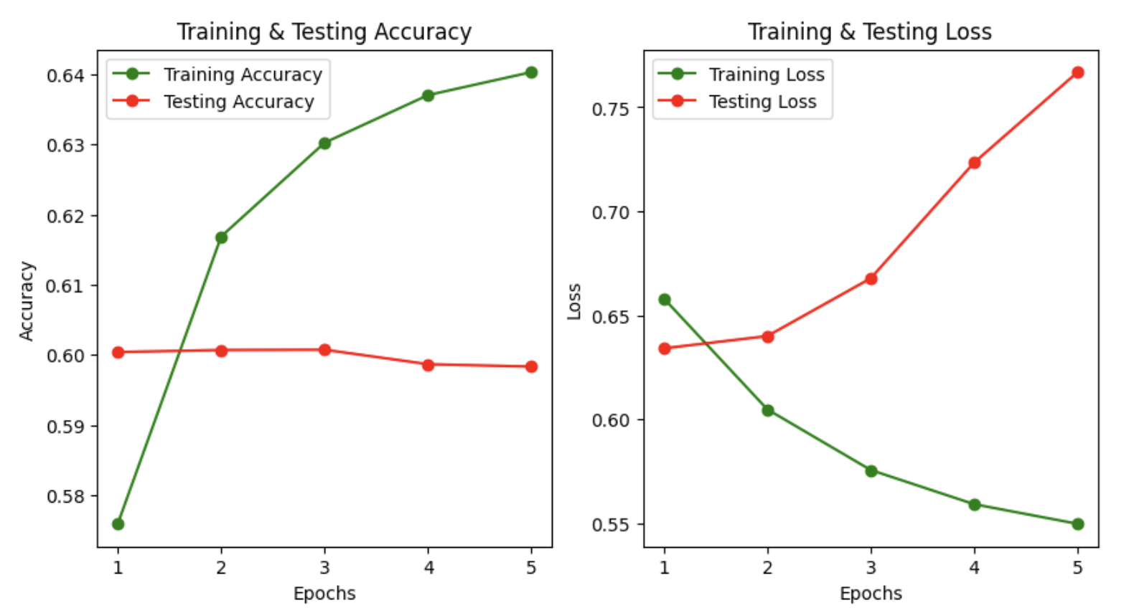
Analysis of LSTM model with accuracy and loss The simpler model with fewer layers is not overfitting as much as the more complex model. However, its performance is poor compared to the complex model. Specifically, the accuracy of the simpler model on the training data is 64.45%, while on the testing data, it is 59.80%.

Slide 17
Word2Vec
Word2Vec is a popular technique in natural language processing (NLP) used to learn distributed representations of words in a continuous vector space. The main idea behind Word2Vec is to represent words as dense, fixed-length vectors, often called word embeddings, in such a way that similar words have similar vector representations.
Word2Vec learns from vast text data to predict target words or surrounding context. Post-training, embeddings capture semantic word relationships, aiding tasks like sentiment analysis and machine translation. Pre-trained embeddings are used in various NLP tasks.

Slide 18
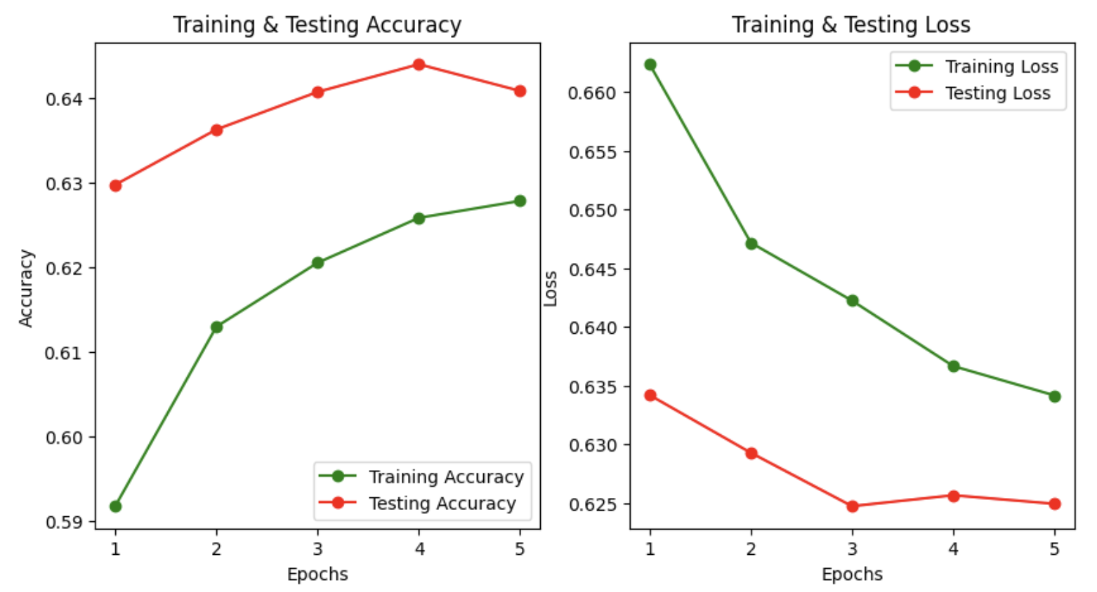
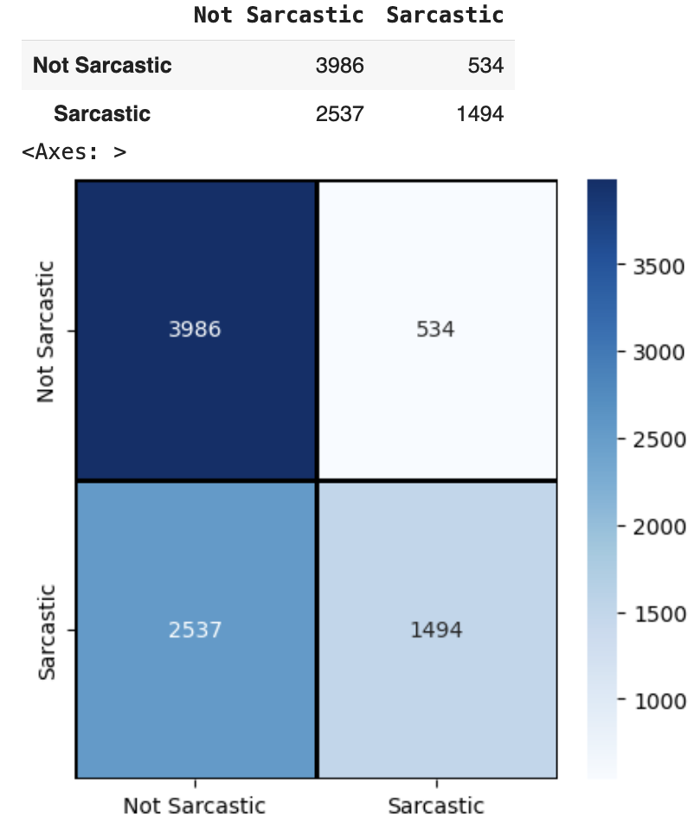
Analysis of Word2Vec model with accuracy and loss

Slide 19
GLOVE
GloVe Integration in Neural Network:
Embedding Matrix Creation:
Constructs embedding matrix (embedding_matrix) to store pre-trained GloVe embeddings (output_dim=100).
Neural Network Definition:
Embedding Layer: Utilizes non-trainable embedding layer with pre-computed embedding_matrix.
Bidirectional LSTM Layer: Incorporates Bidirectional LSTM layer with dropout regularization.
Dense Classification Layer: Appends dense layer with sigmoid activation.
Model Compilation:
Compiles model_glove using Adam optimizer and binary cross-entropy loss

Slide 20
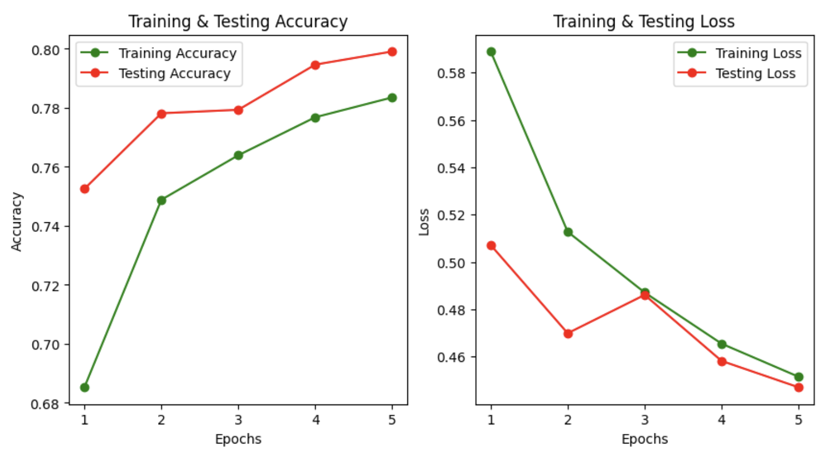
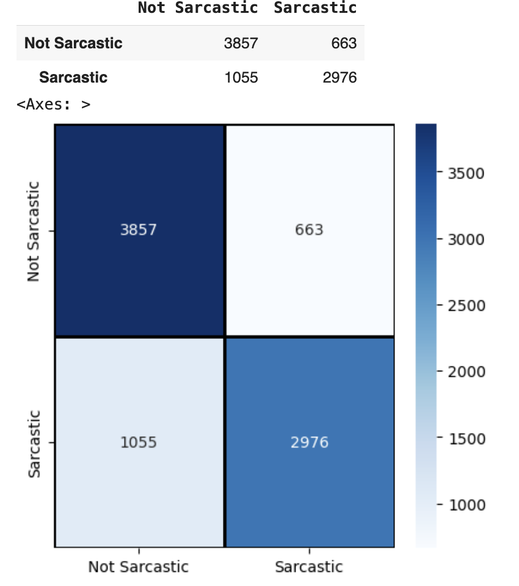
Analysis of Glove model with accuracy and loss

Slide 21
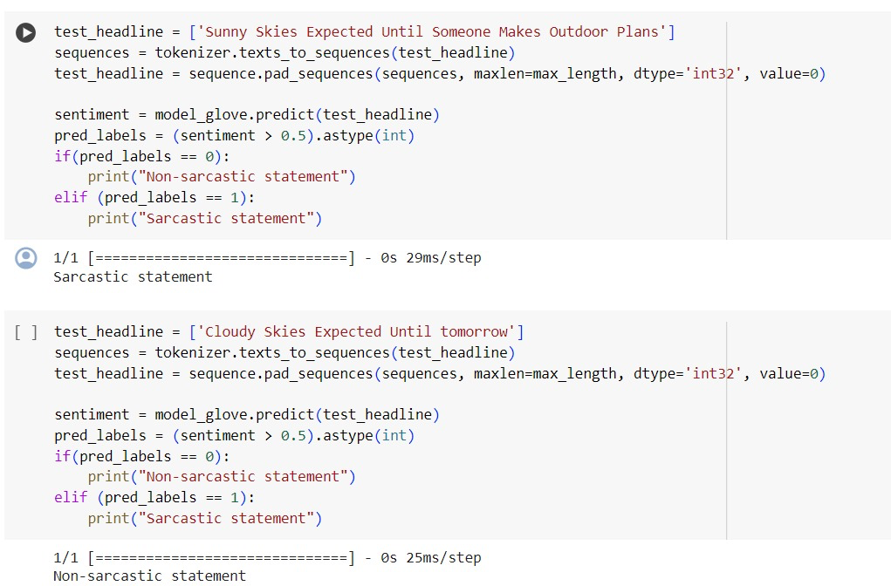
Example tested on our model

Slide 22
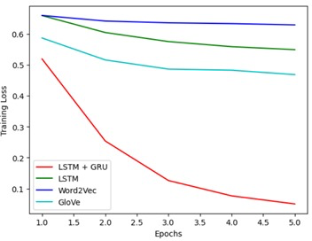
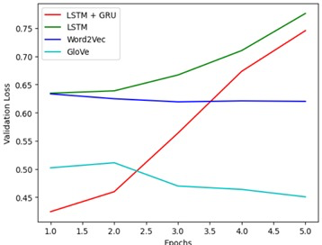
Model Comparision

Slide 23
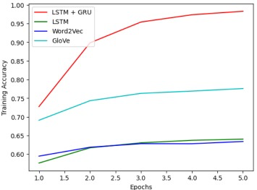
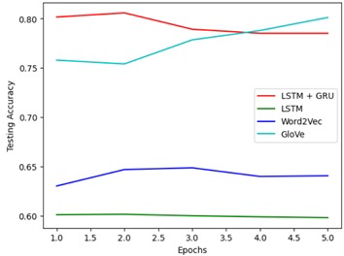
Model Comparision

Slide 24
Conclusions and Future Discussions
In conclusion, this project demonstrates the effectiveness of neural network architectures for sarcasm detection in textual data. Leveraging pre-trained embeddings, particularly GloVe embeddings, significantly enhances model performance.
Future research directions may include exploring ensemble methods, fine-tuning hyperparameters, and incorporating attention mechanisms to further improve model accuracy and robustness in sarcasm detection tasks.
Further optimization and exploration of different architectures, including advanced models like BERT, may yield even better results. BERT, with its powerful bidirectional contextual understanding, has demonstrated remarkable performance in various NLP tasks and holds promise for enhancing sarcasm detection accuracy further.

Slide 25


